Slide 1
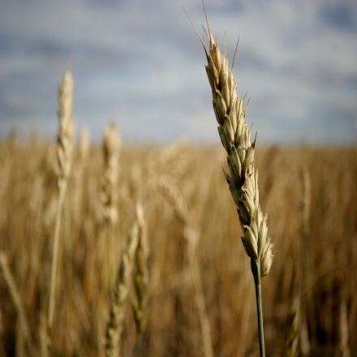
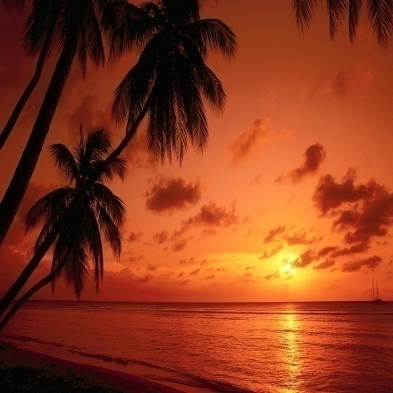
Discover The Truth

Slide 2
Why seek for truth?
Finding and seeking the truth make us:
Happy,
Successful,
Healthy
Jesus Christ said:
(Seek the truth and the truth will set you free)

Slide 3
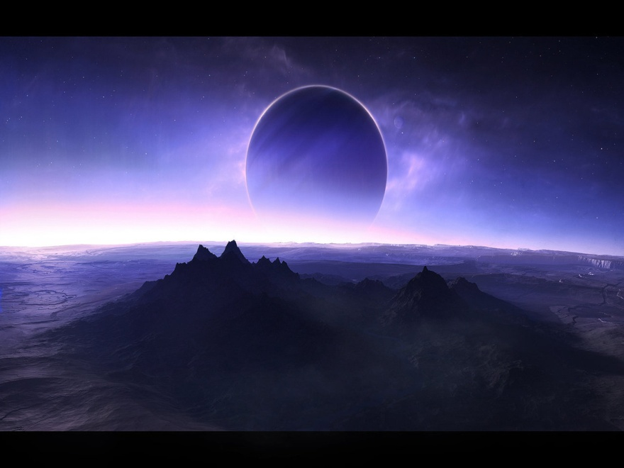
Common Floor /Agreement
There is only one God who created this huge universe (mankind, animal, trees, planets,...)
He is also controlling and mastering it
Do you agree?

Slide 4
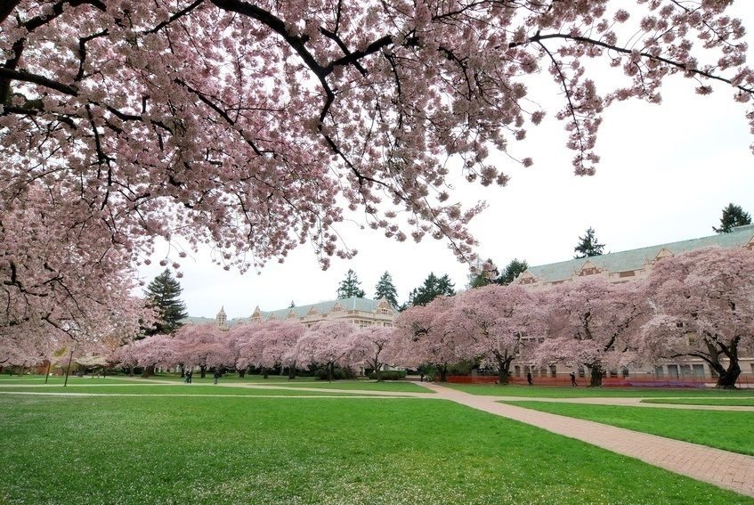
Common Floor /Agreement
This God is the only One Who knows about our needs and requirements
Therefore, He is the only One Who knows abut:
The true life-way
The false life-way
Do you agree?

Slide 5
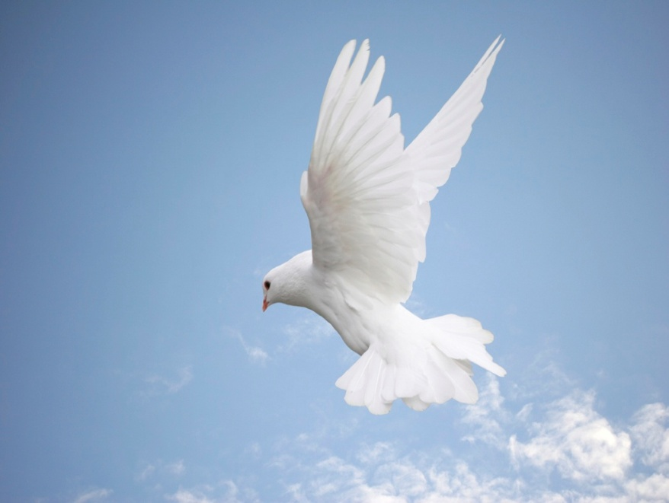
Common Floor /Agreement
This God sent Messengers with Scriptures (Books) to worship him. In addition, to bring peaceful and happy life style for the mankind
Do you agree?

Slide 6
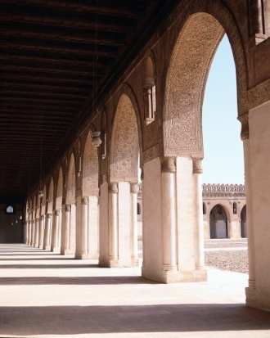
Common Floor /Agreement
Some of these Messengers:
Adam
Noah
Abraham
Moses
Jesus
Muhammad
Do you agree?

Slide 7
Common Floor /Agreement
Only two question…
Who is the God?
Who is the last messenger?

Slide 8
Logical Statement
So by logic and based on the answers /agreements before, we do believe on:
Allah as the Lord
Muhammad is his last messenger
Now
You are believing in Islam as the true religion
Any comments?

Slide 9
Your Choice….
Do you want to discover Islam in five minutes only…….?
YES
NO

Slide 10
The Five Pillars of Islam
1
The Declaration of Faith
There is none worthy of worship except Allah and Muhammad is the messenger of Allah.
أشْهَدُ أنَّ لا إلهَ إلا الْلَّهِ وَأشْهَدُ أنَّ مُحَمَّدً رَسُوْلُ الْلَّهِ
“Ashhadu Alla Ilaha Illa Allah Wa Ashhadu Anna Muhammad Rasulu Allah”

Slide 11
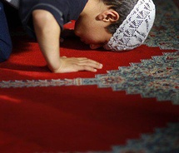
The Five Pillars of Islam
Performing Prays
They are five prayers at five times. Prayer in Islam is a direct link between the mankind and Allah. Each prayer does not take more than a few minutes to perform.
2
Payment of Zakah
Zakah in Arabic means “grow”, “increase”, and “purifying”. So, actually the act of giving Zakah means purifying the wealth to gain Allah's blessing. Practically, is to give 2.5 % of wealth each year to the poor and needy.
3

Slide 12
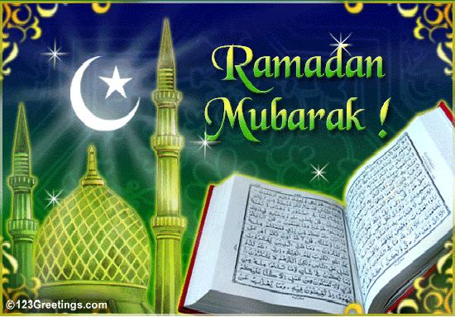
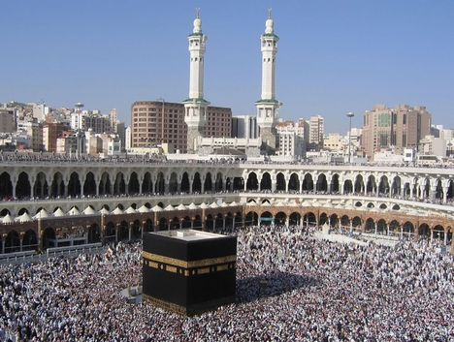
The Five Pillars of Islam
Fasting Ramadan
During the Arabic month of Ramadan, Muslims are requested to abstain from food, eat, and sexual intercourse from dawn until sunset.
4
Pilgrimage
It is the holy trip to Makkah once in lifetime if one can afford it physically and financially.
5

Slide 13
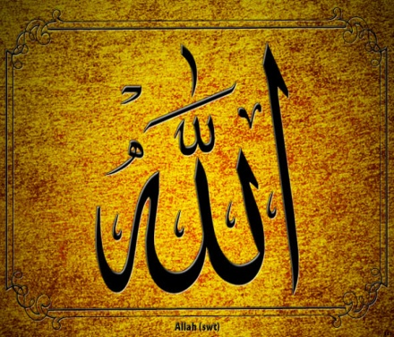
The Pillars of Islam
Shahadh
Prays
Zakah
Fasting
Hajj

Slide 14
Thank You…
miswatch@hotmail.com
0503925046

